Slide 1

2.1 AlphaGO
《机器学习》课件

Slide 2

Schedule
Introduction
Monte-Carlo Tree Search
Policy and Value Networks
Results
Notes:
ˈmɑnti ˈkɑrloʊ The talk will introduce some background about AlphaGo, Monte-Carlo Tree, and also policy and value networks, and the results.

Slide 3
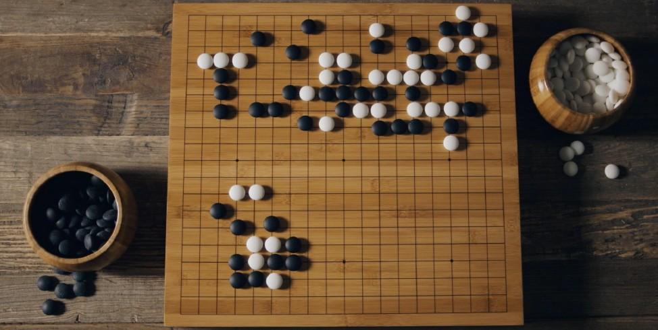
Introduction
Go originated 2,500+ years ago
Currently over 40 million players
Notes:
Go

Slide 4
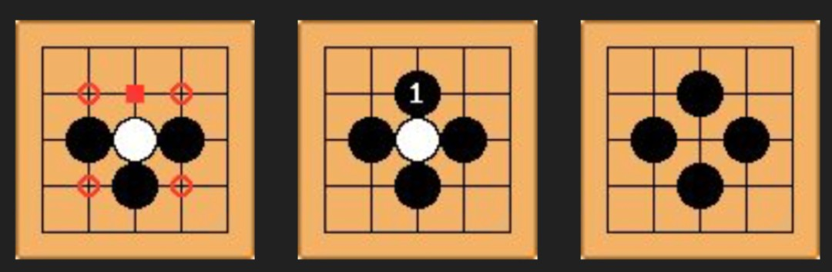
Rules of Go
Played on a 19x19 board
Two players, black and white, each place one stone per turn
Capture the opponent’s stones by surrounding them
Notes:
əˈpoʊnənt

Slide 5
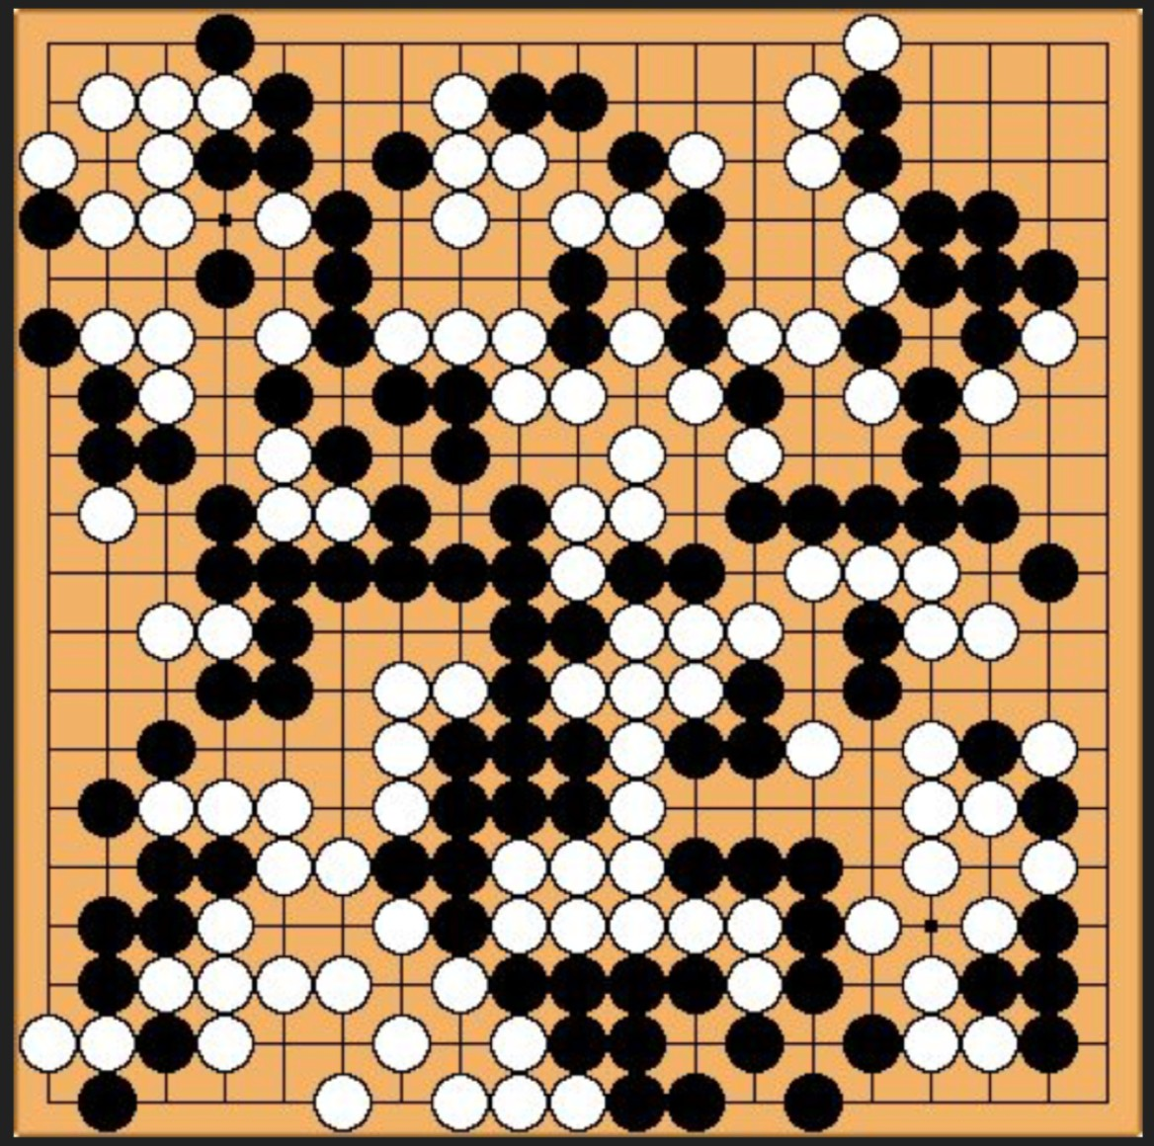
Rules of Go
Goal is to control as much territory as possible.
Notes:
ˈterətɔːri two sides or two countries beat each other, every one wants more territory.

Slide 6
Why is Go Challenging?
Hundreds of legal moves from any position, many of which are plausible
Games can last hundreds of moves
Unlike chess, endgames are too complicated to solve exactly
Heavily dependent on pattern recognition
Notes:
ɪɡˈzæktli

Slide 7

Game Trees
A game tree is a directed graph whose nodes are positions in a game and whose edges are moves
Fully searching this tree allows for best move for simple games like Tic-Tac-Toe
Complexity for tree O(b^{d}), where b is the branching factor (number of legal moves per position), and d is its depth (the length of the game)
Notes:
the game, human player not easy win the pc player, too intelligent, acutally the best solution can be obtained .. Though a simple game, Tic-Tac-Toe is a great mental exercise used to improve the thought process in children and adults ；Marks
三连棋游戏(两人轮流在印有九格方盘上划“+”或“O”字, 谁先把三个同一记号排成横线、直线、斜线, 即是胜者)，可以在线玩

Slide 8
Game Trees
• Chess: b≈35, d≈80, b^{d}≈10⁸⁰
• Go: b≈250, d≈150, b^{d}≈10¹⁷⁰
Size of search tree for Go is more than the number of atoms in the universe!
Brute force intractable

Slide 9
A Brief History of Computer Go
1997: Super human chess w/ Alpha-Beta + fast computer
2005: Computer Go is impossible!
2006: Monte-Carlo Tree Search applied to 9x9 Go (bit of learning)
2007: Human master level achieved at 9x9 Go (more learning)
2008: Human grandmaster level achieved at 9x9 Go (even more learning)
2012: Zen program beats former international champion with only 4 stone handicap in 19x19
2015: DeepMind’s AlphaGo beats European Champion 5:0
2016: AlphaGo beats World Champion 4:1
2017: AlphaGo Zero beats AlphaGo 100:0
Notes:
ˈgrændˈmæstər ˈhændikæp

Slide 10
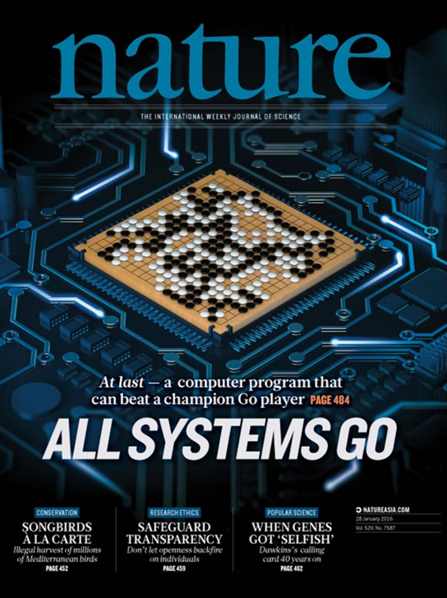
10
Notes:
Alphgo is c omputer program that can beat any champion…but actually a system including 170 cpus there

Slide 11
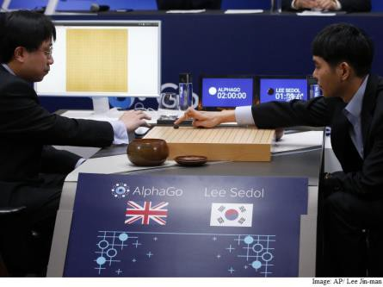
Techniques behind AlphaGo
Deep learning + Monte Carlo Tree Search
+ High Performance Computing
Learn from 30 million human expert moves and 128,000+ self play games
March 2016:
AlphaGo beats Lee Sedol 4-1

Slide 12
Schedule
Introduction
Monte-Carlo Tree Search
Policy and Value Networks
Results

Slide 13
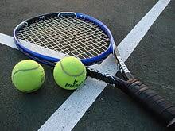
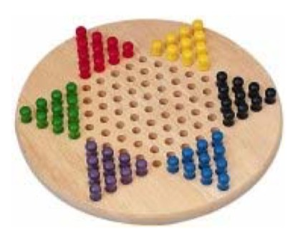
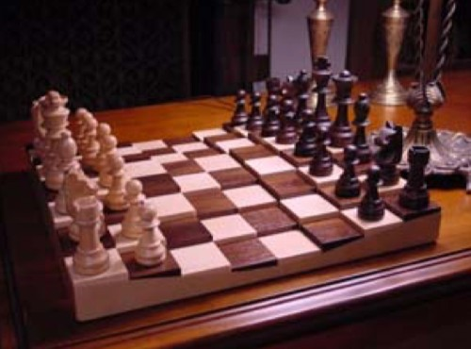
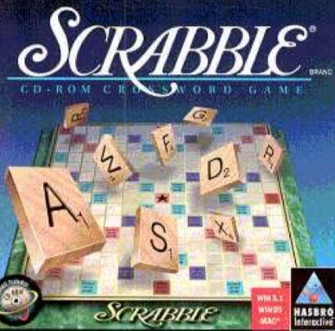
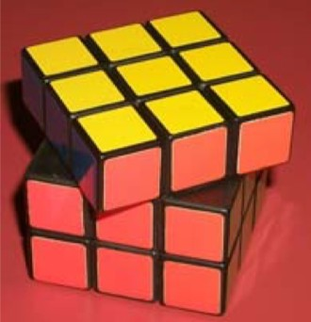
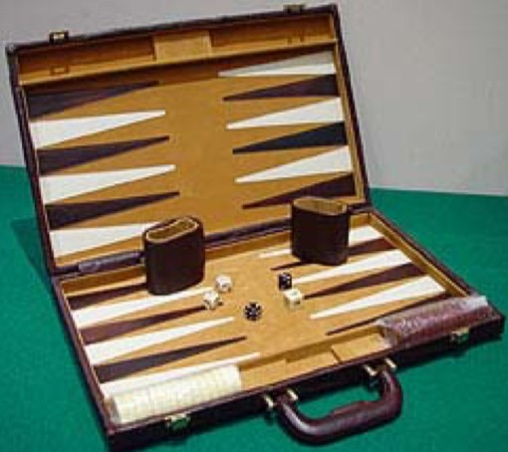
Game Tree Search
Good for 2-player zero-sum finite deterministic games of perfect information
13
Notes:
ˈɪnfɪnət / dɪˌtɜːrmɪˈnɪstɪk

Slide 14





Game Tree Search
Good for 2-player zero-sum finite deterministic games of perfect information
14
Notes:
ɪnfɪnət / dɪˌtɜːrmɪˈnɪstɪk

Slide 15
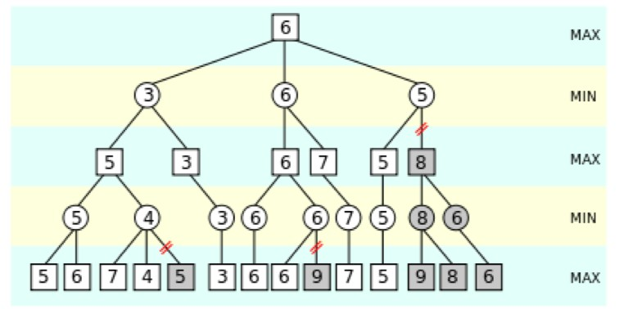
Conventional Game Tree Search
Minimax algorithm with alpha-beta pruning
Effective
When modest branching factor
When a good heuristic value function is known
Notes:
hjuˈrɪstɪk Here I will first introduce the conventional Gabor tree search method. Two players, min, max, how to compete with each other. The method is only effective for easy game, but not Go. It is good for Chinese chess. The alpha-beta pruning not affect the final results, but speed up the inference process.

Slide 16
Foundations of Artificial Intelligence

Slide 17
Outline
Game Playing
Optimal decisions
Minimax
α-β pruning
Notes:
This the outline of the talk about alpha-beta pruning. Here I just briefly introduce the idea, if you are interested in the topic, you should try to implement it. And then you can get the idea completely.

Slide 18
Game Playing
Mathematical Game Theory
Branch of economics that views any multi-agent environment as a game, provided that the impact of each agent on the others is “significant”, regardless of whether the agents are cooperative or competitive.
诺贝尔奖 美丽心灵 A Beautiful Mind
约翰·纳什是著名数学家，生前一直在普林斯顿任教，在1994年因博弈论获得诺贝尔经济学奖。他换有精神分裂症，而电影《美丽心灵》就是讲述纳什一生在博弈论上取得的突破性成就及其与精神分裂症抗争的感人事迹，曾获第74届奥斯卡最佳影片和最佳导演大奖。
Game Playing in AI (typical case) :
2-player
Zero-sum game of perfect information (fully observable)零和博弈
Notes:
kəmˈpetətɪv koʊˈɑːpərətɪv] John Nash is a mathematician and economist who concentrated primarily on game theory and differential geometry; His work in game theory, especially the “Nash equilibrium ˌiːkwɪˈlɪbriəm ,” has reshaped modern economic thought. He won the 1994 Nobel Prize in Economics for the Nash equilibrium ; Branch of economics that views any multi-agent environment as a game, provided that the impact of each agent on the others is “significant”, regardless of whether the agents are cooperative or competitive.

Slide 19
Game Playing vs. Search
Game vs. search problem
"Unpredictable" opponent → specifying a move for every possible opponent reply
Time limits → unlikely to find goal, must approximate
Notes:
ˌʌnprɪˈdɪktəbl

Slide 20
Game Playing
Formal definition of a game:
Initial state
Successor function: returns list of (move, state) pairs
Terminal test: determines when game over
Terminal states: states where game ends
Utility function (objective function or payoff function): gives numeric value for terminal states
We will consider games with 2 players (Max and Min);
Max moves first.
Notes:
səkˈsesər nuˈmɛrɪk] juːˈtɪləti ˈfʌŋkʃn

Slide 21
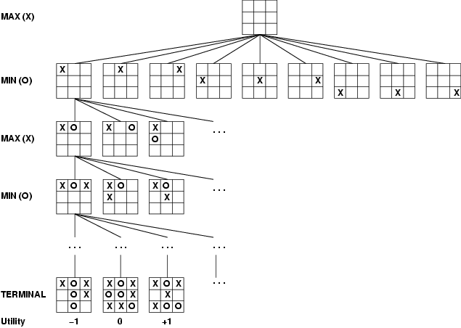
Game Tree Example: Tic-Tac-Toe
Tree from
Max’s
perspective
Notes:
Crosses and noughts marks by placing the three same marks into a horizontal, vertical, diagonal lines

Slide 22
Minimax Algorithm
Minimax algorithm
Perfect play for deterministic, 2-player game
Max tries to maximize its score
Min tries to minimize Max’s score (Min)
Goal: move to position of highest minimax value
→ Identify best achievable payoff against best play
Notes:
[əˈtʃiːvəbl]

Slide 23
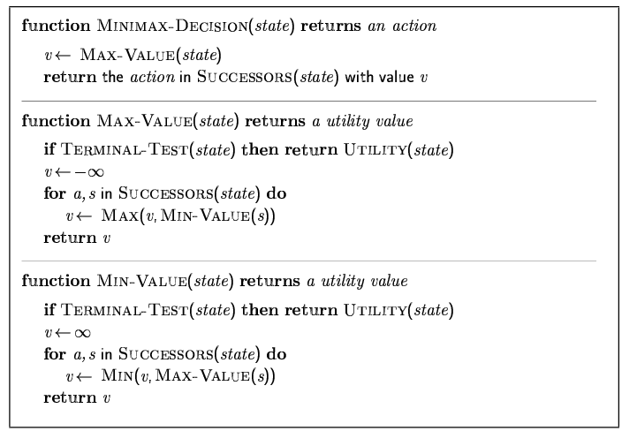
Minimax Algorithm

Slide 24
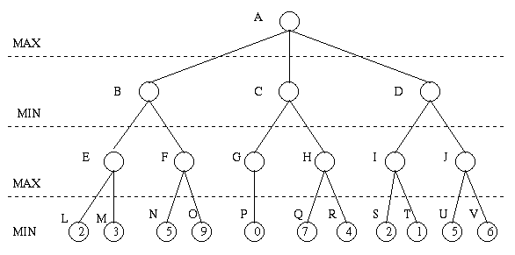
Minimax Algorithm
Payoff for Max
Notes:
To choose a better move, for the max player, it will simulate and go forward two steps. Generally, for a real game, human player did the similar things, also simulate in their mind.

Slide 25
Minimax Algorithm (cont’d)
3
9
0
7
2
6
Payoff for Max
Notes:
At the current state maybe you will choose the state that make you gain biggest reward, but min will minimize your reward, that means the opponent should be also very smart. It will choose the action.

Slide 26
Minimax Algorithm (cont’d)
3
0
2
3
9
0
7
2
6
Payoff for Max

Slide 27
Minimax Algorithm (cont’d)
3
3
0
2
3
9
0
7
2
6
Payoff for Max
Notes:
That is a real brain-inspired algorithm, which is really smart idea. Based on which, you can choose the move that is the best for you.

Slide 28
Minimax Algorithm (cont’d)
Properties of minimax algorithm:
Complete? Yes (if tree is finite)
Optimal? Yes (against an optimal opponent)
Time complexity? O(b^{m})
Space complexity? O(bm) (depth-first exploration, if it generates all successors at once)
m – maximum depth of tree; b branching factor
For chess, b ≈ 35, m ≈100 for "reasonable" games → exact solution completely infeasible
m – maximum depth of the tree; b – legal moves;

Slide 29
Minimax Algorithm
Limitations
Not always feasible to traverse entire tree
Time limitations
Key Improvement
Use evaluation function instead of utility
Evaluation function provides estimate of utility at given position
→ More soon…
Notes:
Similar to heuristic function

Slide 30
α-β Pruning
Can we improve search by reducing the size of the game tree to be examined?
→ Yes!!! Using alpha-beta pruning
Principle
If a move is determined worse than another move already examined, then there is no need for further examination of the node.

Slide 31
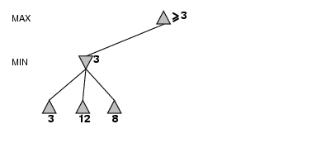
α-β Pruning Example

Slide 32
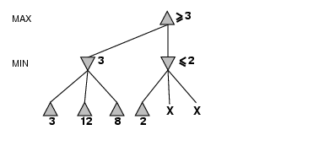
α-β Pruning Example (cont’d)

Slide 33
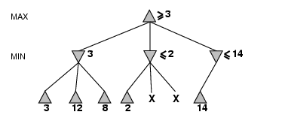
α-β Pruning Example (cont’d)

Slide 34
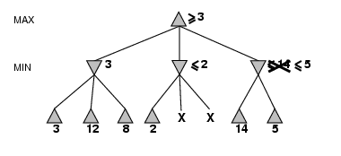
α-β Pruning Example (cont’d)

Slide 35
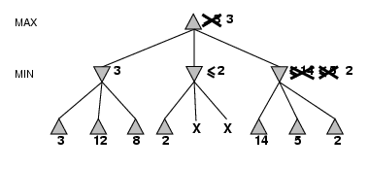
α-β Pruning Example (cont’d)

Slide 36
Alpha-Beta Pruning (αβ prune)
Rules of Thumb
α is the best ( highest) found so far along the path for Max
β is the best (lowest) found so far along the path for Min
Search below a MIN node may be alpha-pruned if the its β ≤ α of some MAX ancestor
Search below a MAX node may be beta-pruned if the its α≥ β of some MIN ancestor.

Slide 37
Alpha-Beta Pruning Example
Search below a MIN node may be alpha-pruned if the beta value is <= to the alpha value of some MAX ancestor.
2. Search below a MAX node may be beta-pruned if the alpha value is >= to the beta value of some MIN ancestor.

Slide 38
Alpha-Beta Pruning Example
Search below a MIN node may be alpha-pruned if the beta value is <= to the alpha value of some MAX ancestor.
2. Search below a MAX node may be beta-pruned if the alpha value is >= to the beta value of some MIN ancestor.
3
3
3

Slide 39
Alpha-Beta Pruning Example
Search below a MIN node may be alpha-pruned if the beta value is <= to the alpha value of some MAX ancestor.
2. Search below a MAX node may be beta-pruned if the alpha value is >= to the beta value of some MIN ancestor.
3
3
3
5
β

Slide 40
Alpha-Beta Pruning Example
Search below a MIN node may be alpha-pruned if the beta value is <= to the alpha value of some MAX ancestor.
2. Search below a MAX node may be beta-pruned if the alpha value is >= to the beta value of some MIN ancestor.
3
3
0
α
3
5
0
β

Slide 41
Alpha-Beta Pruning Example
Search below a MIN node may be alpha-pruned if the beta value is <= to the alpha value of some MAX ancestor.
2. Search below a MAX node may be beta-pruned if the alpha value is >= to the beta value of some MIN ancestor.
3
3
0
2
α
α
3
5
0
2
β

Slide 42
α-β Search Algorithm
If terminal state, compute e(n) and return the result.
Otherwise, if the level is a minimizing level,
Until no more children or
search on a child
If
Return min
Otherwise, the level is a maximizing level:
Until no more children or
search on a child.
If
Return
pruning
pruning
See page 170 R&N

Slide 43
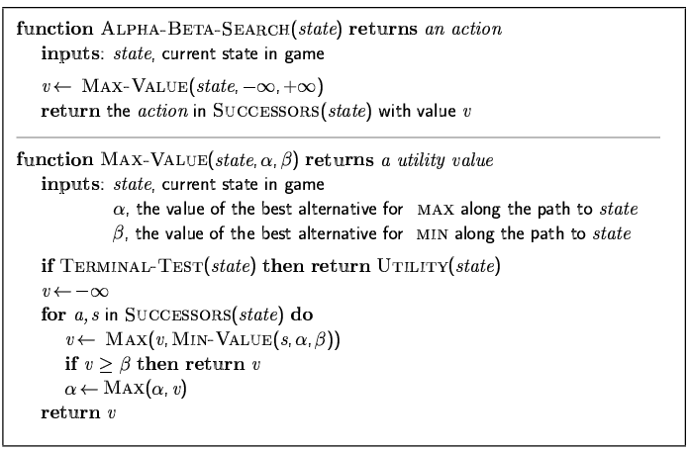
The α-β algorithm

Slide 44
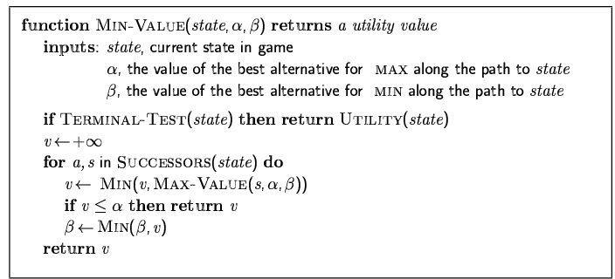
The α-β algorithm

Slide 45
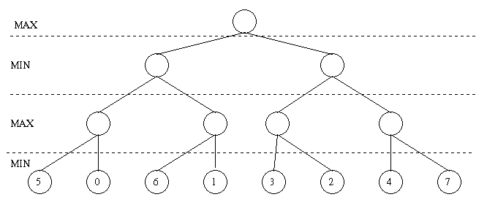
Another Example
Search below a MIN node may be alpha-pruned if the beta value is <= to the alpha value of some MAX ancestor.
2. Search below a MAX node may be beta-pruned if the alpha value is >= to the beta value of some MIN ancestor.

Slide 46
Example
Search below a MIN node may be alpha-pruned if the beta value is <= to the alpha value of some MAX ancestor.
2. Search below a MAX node may be beta-pruned if the alpha value is >= to the beta value of some MIN ancestor.
5
5
3
5
3
5
6
3
7
α
5
6
3
5
0
6
1
3
2
4
7
β

Slide 47
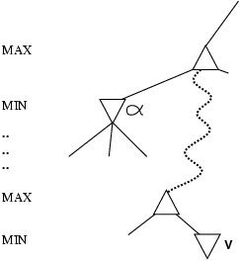
Why is it called α-β?
α is the value of the best (i.e., highest-value) choice found so far at any choice point along the path for max
If v is worse than α, max will avoid it
→ prune that branch
Define β similarly for min

Slide 48
Properties of α-β Prune
Pruning does not affect final result
Good move ordering improves effectiveness of pruning b(e.g., chess, try captures first, then threats, froward moves, then backward moves…)
With "perfect ordering," time complexity = O(b^{m/2})
→ doubles depth of search that alpha-beta pruning can explore
Example of the value of reasoning about which
computations are relevant (a form of metareasoning)

Slide 49
Summary
Game playing was one of the first tasks undertaken in AI as soon as computers became programmable (e.g., Turing, Shannon, Wiener tackled chess).
Game playing research has spawned a number of interesting research ideas on search, data structures, databases, heuristics, evaluations functions and many areas of computer science.
Games are fun:
Teach your computer how to play a game!
Notes:
Game playing was one of the first tasks undertaken in AI as soon as computers became programmable (e.g., Turing, Shannon, Wiener tackled chess).

Slide 50
Alpha-beta pruning for Go?
Branching factor for Go is too large
250 moves on average
Order of magnitude greater than the branching factor of 35 for chess
Lack of good evaluation function
Too subtle to model: similar looking positions can have completely different outcomes
Notes:
ˈsʌtl

Slide 51
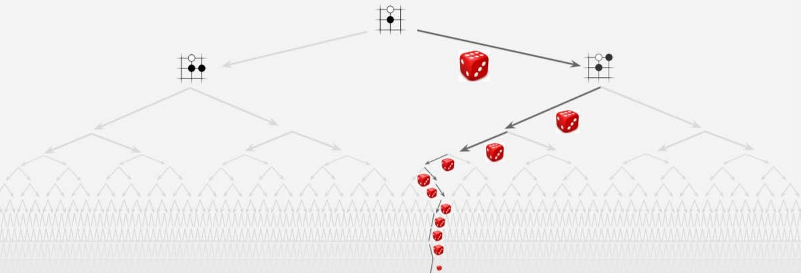
Monte-Carlo Tree Search
Heuristic search algorithm for decision trees
Application to deterministic game pretty recent (less than 10 years)
17
Notes:
dɪˌtɜːrmɪˈnɪstɪk hjuˈrɪstɪk

Slide 52
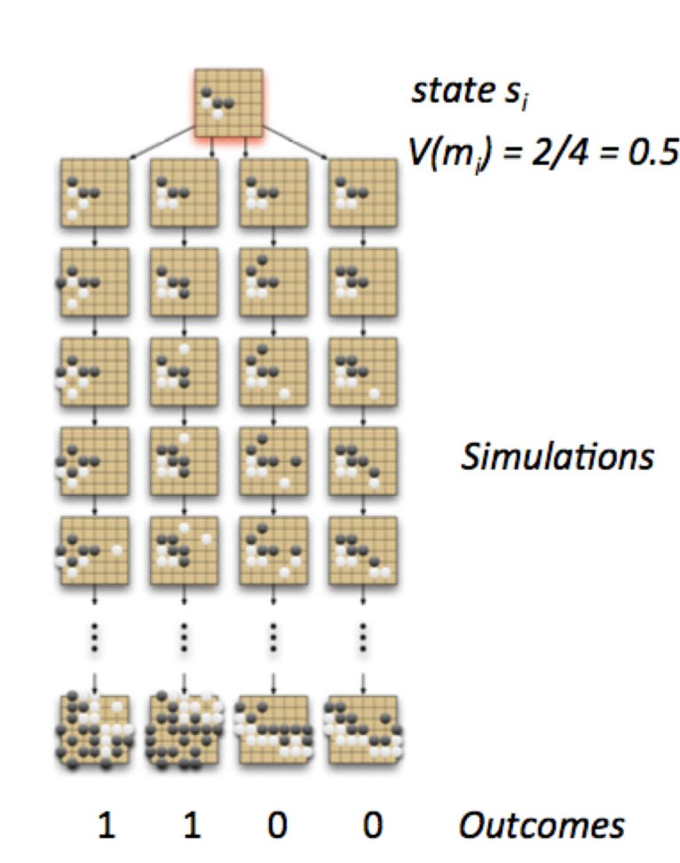
Basic Idea
No evaluation function?
Simulate game using random moves
Score game at the end, keep winning statistics
Play move with best winning percentage
Repeat
18
Notes:
Skɔːr

Slide 53
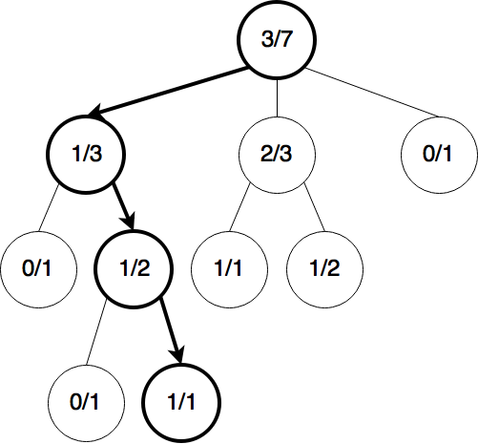
Monte Carlo Tree Search
(1) Selection
Selection policy is applied recursively until a leaf node is
reached
19

Slide 54
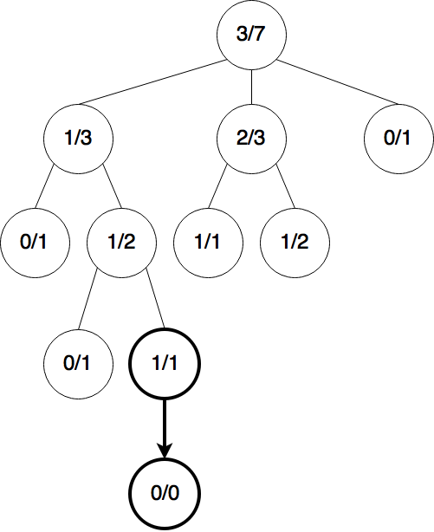
Monte Carlo Tree Search
(2) Expansion
One or more nodes
are created.
20

Slide 55
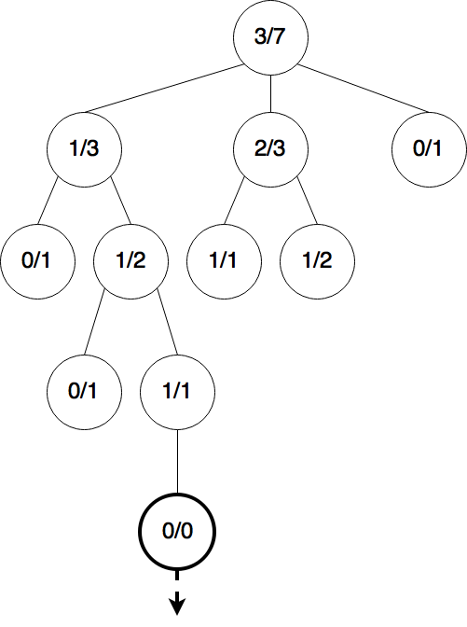
Monte Carlo Tree Search
(3) Simulation
One simulated game is played.

Slide 56
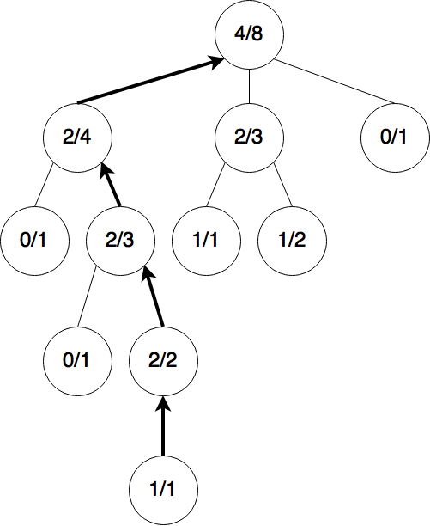
Monte Carlo Tree Search
(4) Backpropagation

Slide 57
Naïve Monte Carlo Tree Search
Use simulation directly as an evaluation function for alpha-beta pruning
Problems for Go
Single simulation is very noisy, only 0/1signal
Running many simulations for one evaluation is very slow, e.g., typical speed for chess is 1 million eval/sec, for Go is only 25 eval/sec
Result: MCTS is ignored for over 10 years in computer Go

Slide 58
Monte Carlo Tree Search
Use results of simulation to guide the growth of the game tree
What moves are interesting to us?
Promising moves (simulated and won most)
Moves where uncertainty about evaluation are high (less simulated)
Seems two contradictory goals
Theory of bandits can help

Slide 59
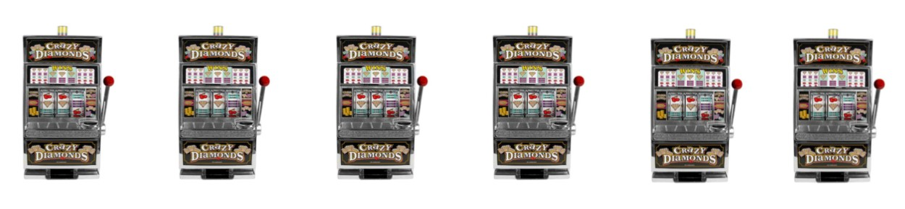
Multi-Armed Bandit Problem
Assumptions
Choice of several arms
Each arm pull is independent of other pulls
Each arm has fixed, unknown average payoff
Which arm has the best average payoff?

Slide 60
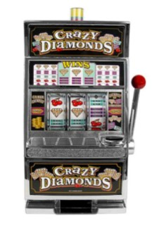
Multi-Armed Bandit Problem
P(A wins)=45% P(B wins)=47% P(C wins)=30%
But we don’t know the probability, how do we choose a good one?
With infinite time, we may try each one for infinite times to estimate the probability
But in practice?

Slide 61
Exploration strategy
Want to explore all arms
We don’t want to miss any potentially good arm
But, if we explore too much, may sacrifice the reward we could have gotten
Want to exploit promising arms more often
Good arms worth further investigation
But, if we exploit too much, may get stuck with
sub-optimal values
27

Slide 62
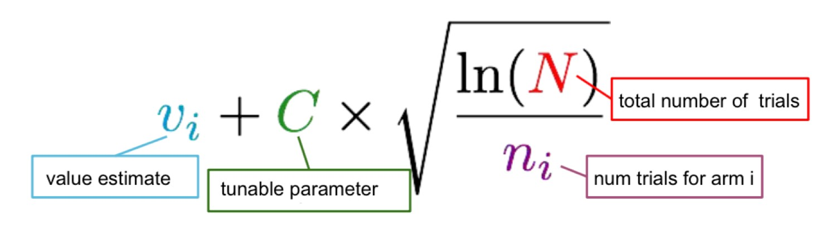


Upper Confidence Bound
Policy
First, try each move once
Then, at each time step
Choose the move that maximizes formula:
Prefers higher payoff mover
Prefers less played move₂₈

Slide 63
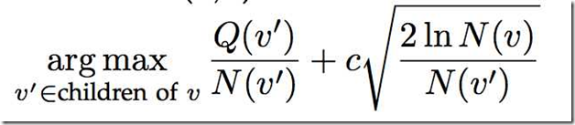
Upper Confidence Bound
Policy
First, try each move once
Then, at each time step
Choose the move that maximizes formula:
Prefers higher payoff mover
Prefers less played move₂₈

Slide 64
Schedule
Introduction
Monte-Carlo Tree Search
Policy and Value Networks
Results

Slide 65
Policy and Value Networks
Goal: Reduce both branching factor and depth of search tree
How?
Use policy network to explore better (and fewer) moves
How?
Use value network to estimate lower branches of tree (rather than simulating to the end)
How?
They did not release the source code, less details about the method. But we can briefly understand the idea.

Slide 66
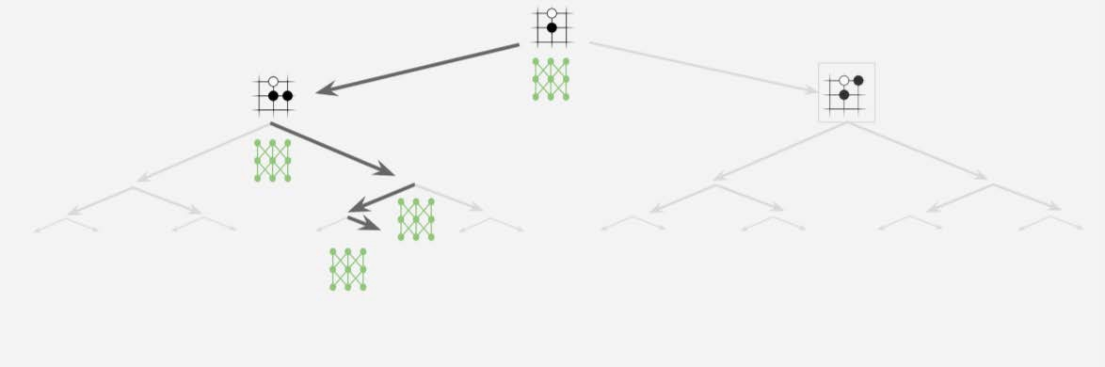
Policy and Value Networks
Reducing branching factor: Policy Network

Slide 67
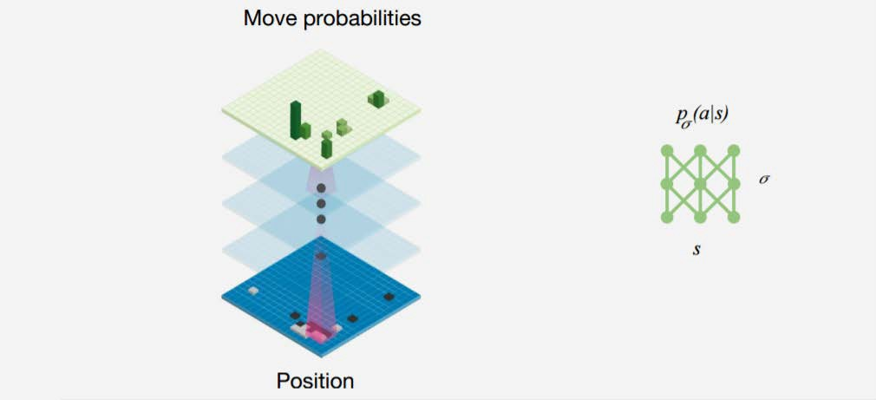
Policy and Value Networks
Predicts the probability of a move being best move

Slide 68
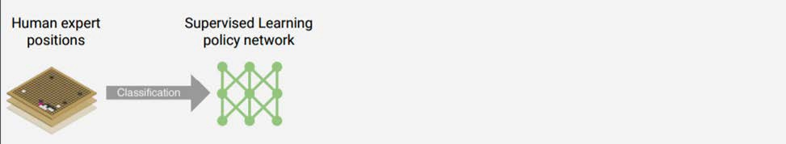
Policy and Value Networks
Supervised learning
Training data: 30 million positions from human expert games
Likelihood of a human move selected at a state s
Training time: 4 weeks
Results: predicted human expert moves with 57% accuracy
Notes:
ˈlaɪklihʊd prɪˈdɪktɪd

Slide 69
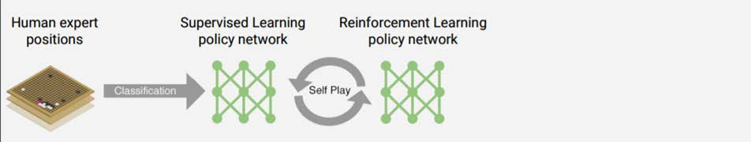
Policy and Value Networks
Reinforcement learning
Training data: 128,000+ games of self-play using policy network in 2 stages
Training algorithm: maximize wins of the action
∆𝛔
Training time: 1 week
Results: won more than 80% games vs.
supervised learning

Slide 70
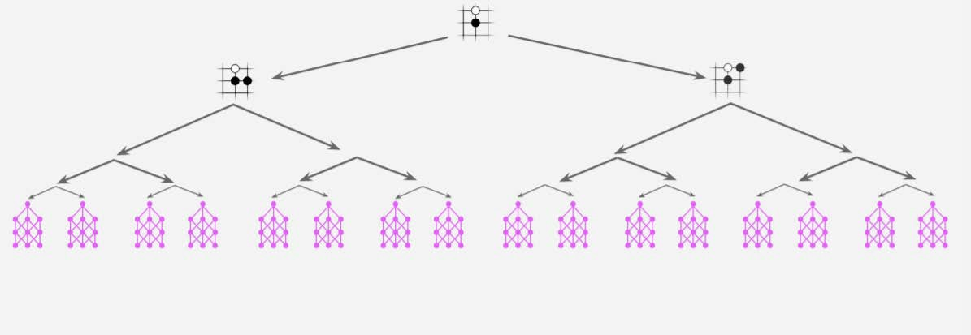
Policy and Value Networks
Reducing depth: Value Network
Given board states, estimate probability of victory
•
No need to simulate to the end of the game
Notes:
That actually means that the board is considered as an image, then input to deep learning models for an evaluation. That should one of the most exicting part of AlphaGo. Of course we should also consider the reinforcement learning as another significant part of the knowledge.

Slide 71
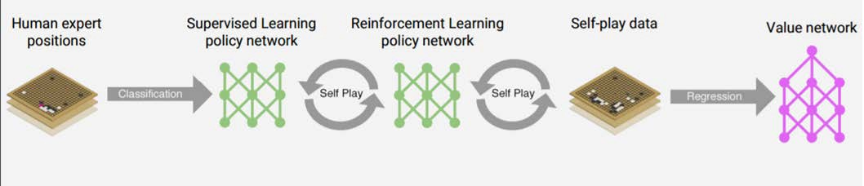
Policy and Value Network
Reinforced learning
Training data: 30 million games of self-play
Training algorithm: minimize mean-squared error by stochastic gradient descent
Training time: 1 week
•
Results: AlphaGo ready for playing against pros
Notes:
stə'kæstɪk ˈɡreɪdiənt dɪˈsent

Slide 72
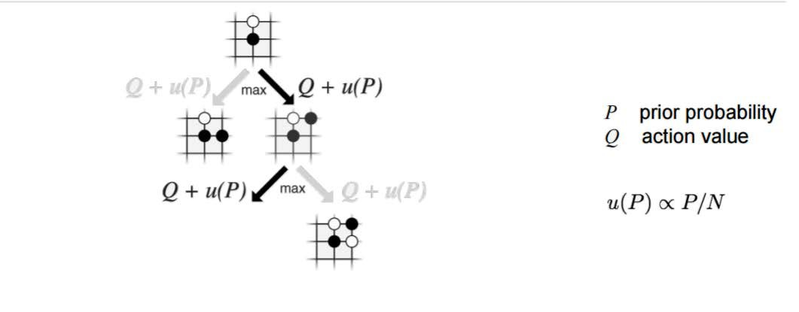
MCTS + Policy / Value Networks
Selection
Q+u(P)
Initially no simulation yet, so action value = 0, prefers high prior probability and low visits count
prefers actions with high action value.
37

Slide 73
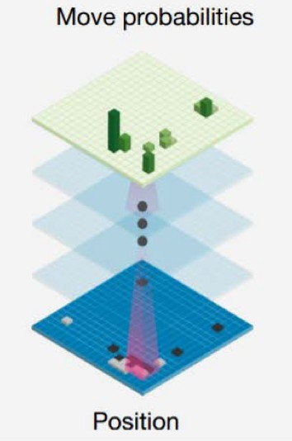
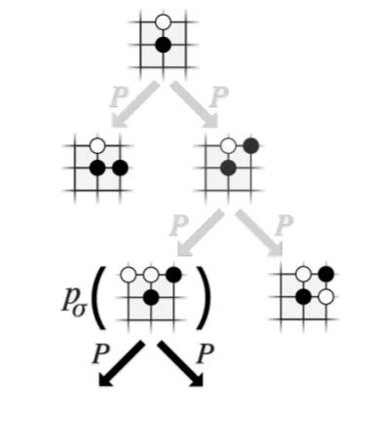
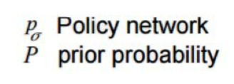
MCTS + Policy / Value Networks
Expansion

Slide 74
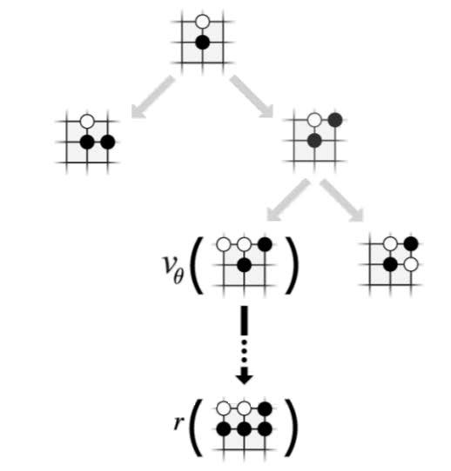
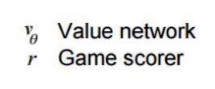
MCTS + Policy / Value Networks
Simulation
Run multiple simulations in parallel
Some with value network
Some with rollout to the end of the game

Slide 75
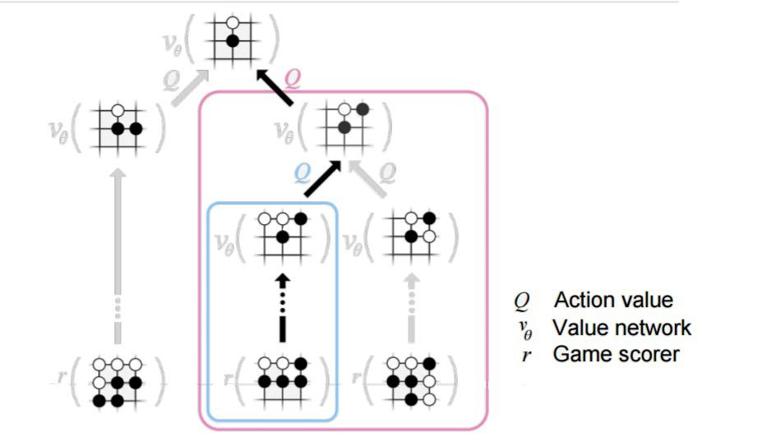
MCTS + Policy / Value Networks
Propagate values back to root
40

Slide 76
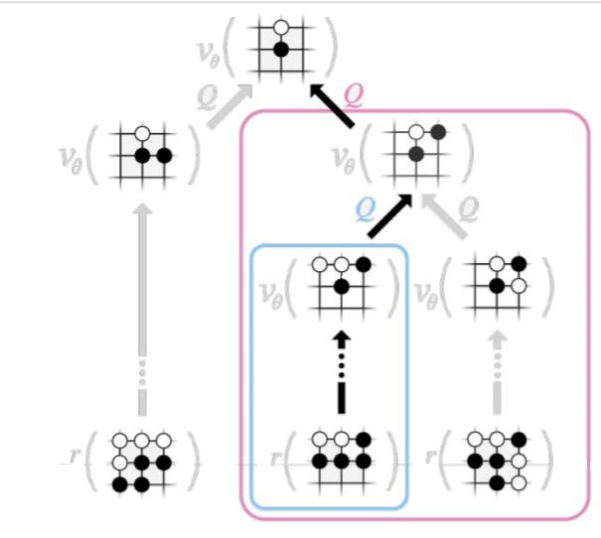
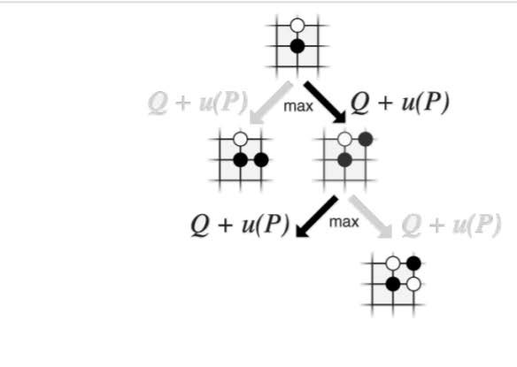
MCTS + Policy / Value Networks
Repeat
Selection

Slide 77
AlphaGo Zero
AlphaGo
Supervised learning from human expert moves
Reinforcement learning from self-play
AlphaGo Zero
Solely reinforcement learning from self-play

Slide 78
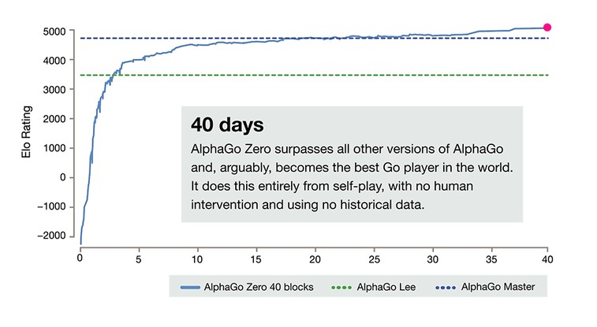
AlphaGo Zero
Beats AlphaGo by 100:0
43

Slide 79

What’s next for AI?
Go is still in the “easy” category of AI problems.
Notes:
[əbˈzɜːrvəbl] [dɪˌtɜːrmɪˈnɪstɪk]

Slide 80

What’s next for AI?

Slide 81

What’s next for AI?
The idea of combining search with learning is very general and is widely applicable.

Slide 82
References
Silver, David, et al. "Mastering the game of Go with deep neural networks and tree search." Nature 529.7587 (2016): 484-489.
Silver, David, et al. "Mastering the game of go without human knowledge." Nature 550.7676 (2017): 354-359.
Introduction to Monte Carlo Tree Search, by Jeff Bradberry https://jeffbradberry.com/posts/2015/09/intro- to-monte-carlo-tree-search/
Homework 1, please write one page of summary and also your understanding about AlphaGo.
In one page both in hard copy and also the electrical one to me. 1810283086@qq.com

